Slide 3
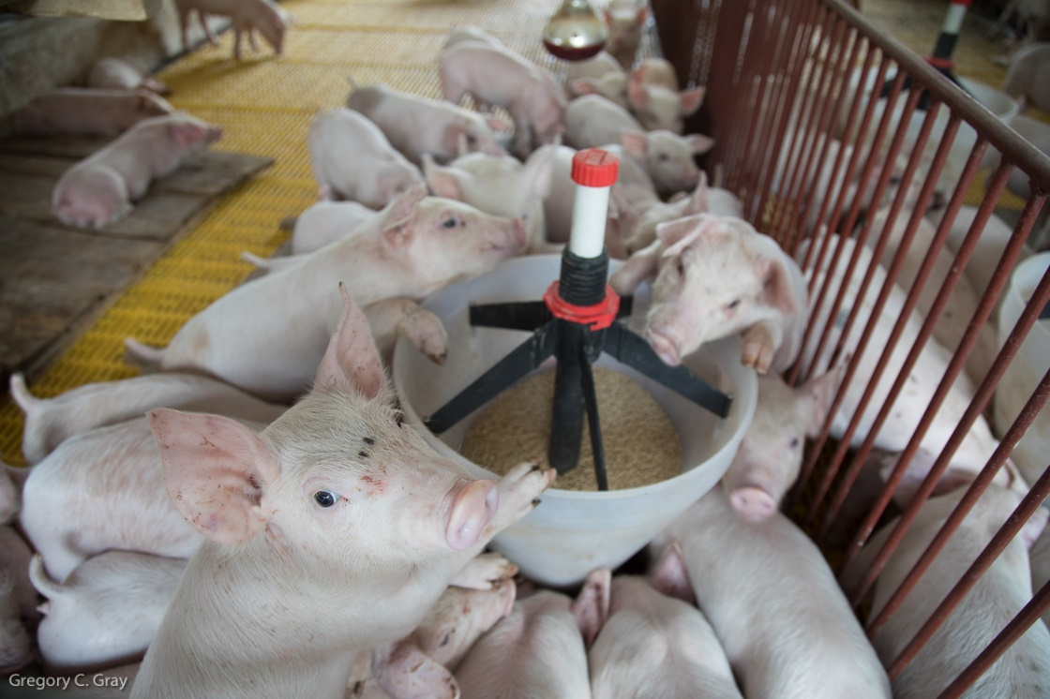
Environmental Pathogens and Risk Assessment
Emily S. Bailey, PhD
November 4, 2022
Notes:
Add photo to this slide

Slide 4
Notes:
Virus hunter – interest with board game

Slide 5
From http://www.iisertvm.ac.in/faculties/stalin/research_areas.phpx

Slide 6
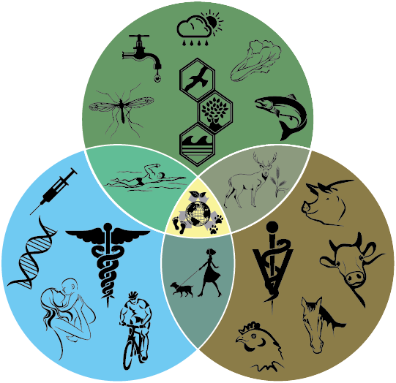
One Health
“The integrative effort of multiple disciplines working locally, nationally, and globally to attain optimal health for people, animals, and the environment” -AVMA
Notes:
Do better job of linking to the figure

Slide 7
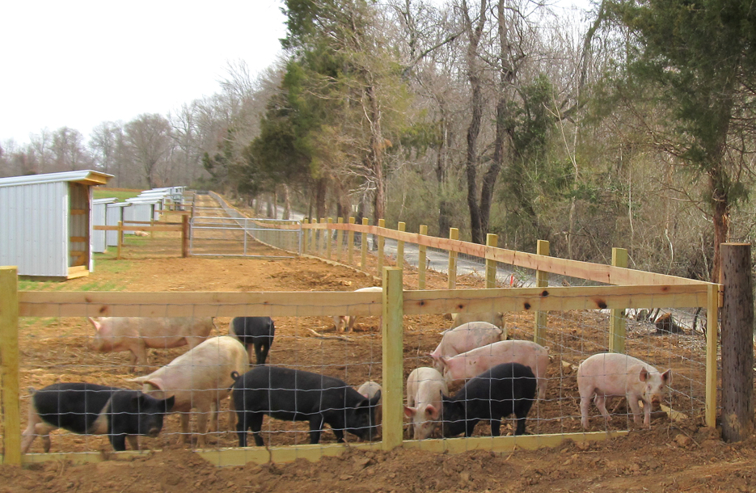
Small Family Farm
www.carolineprogress.com

Slide 8
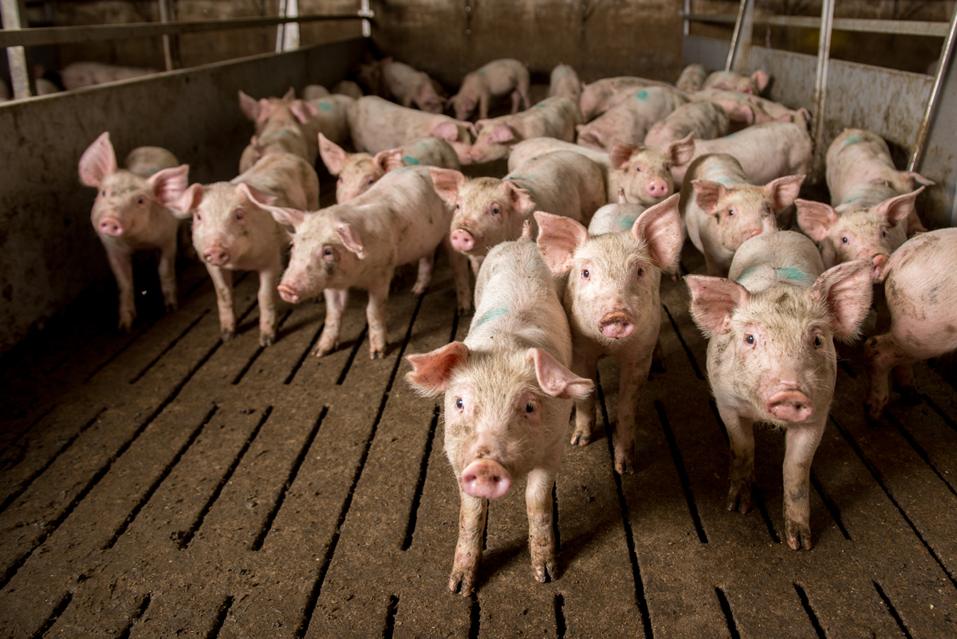
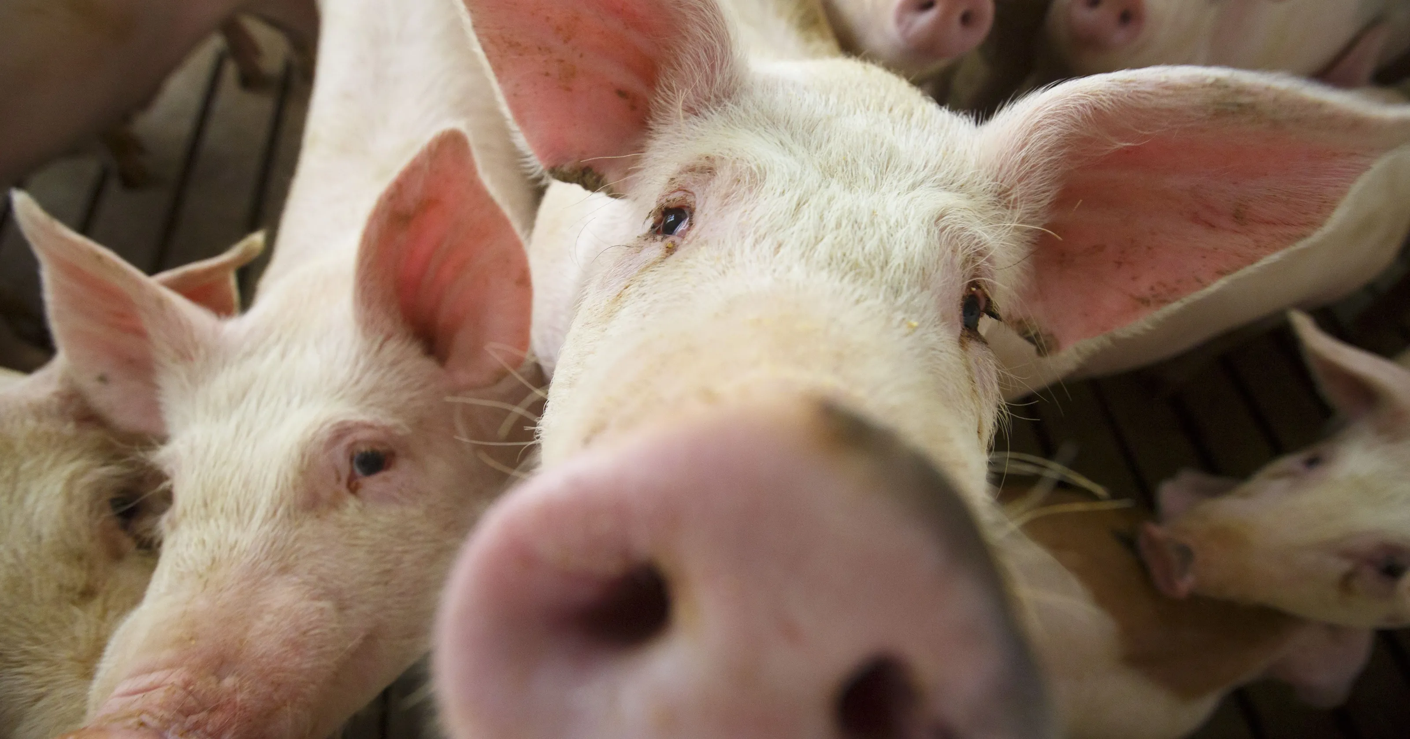
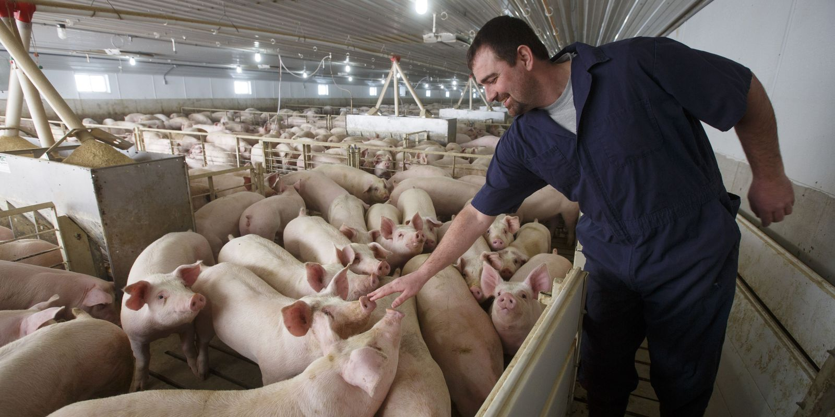
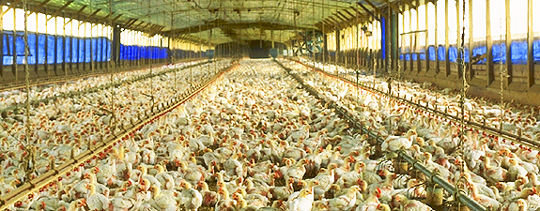
Notes:
Define CAFOs

Slide 9
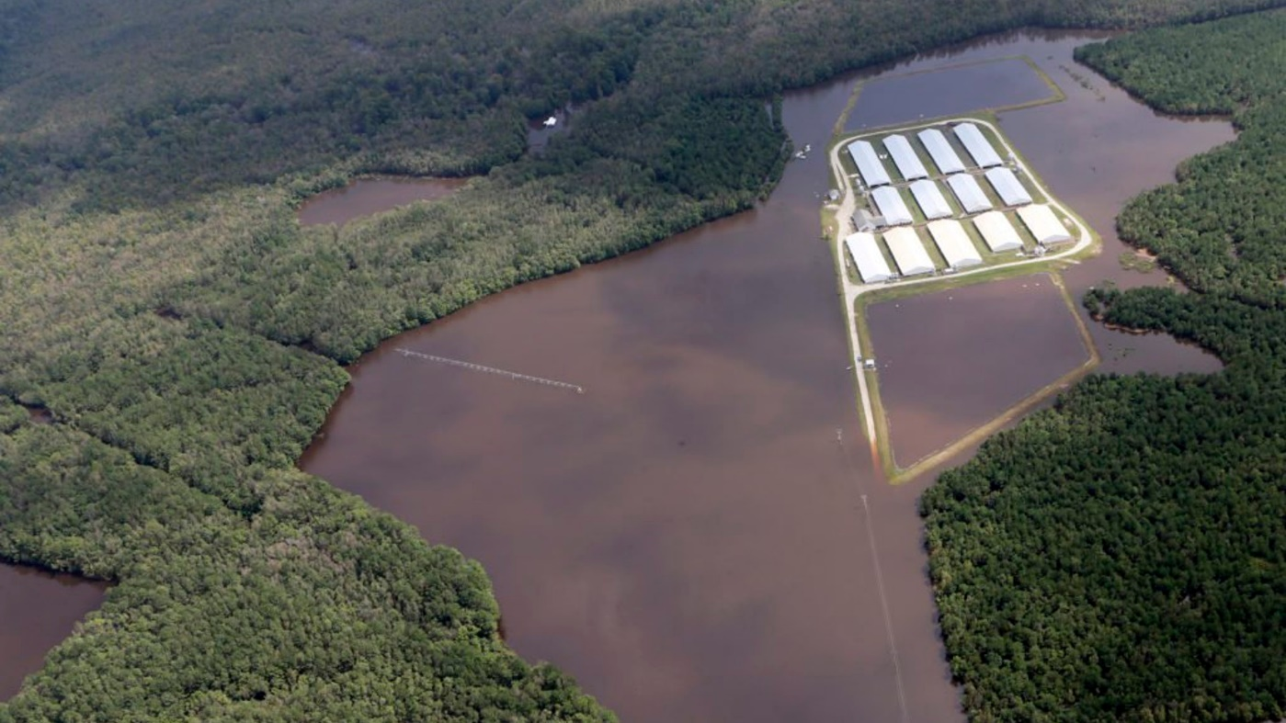
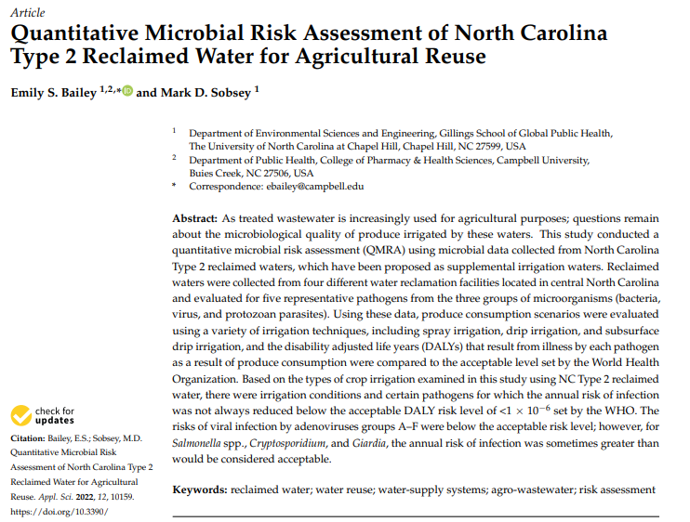
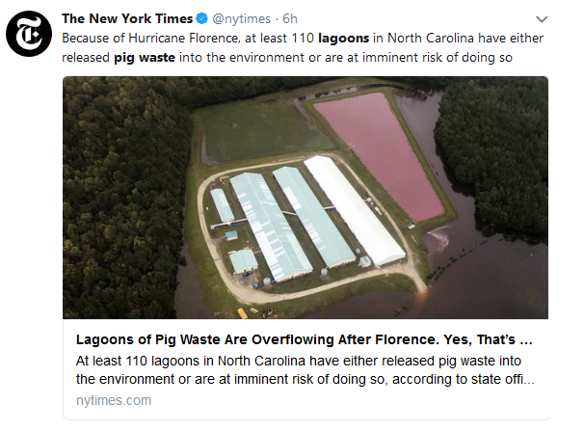
Notes:
What we may think of in NC
Not only an environmental issue, but also a public perception problem. Need to engage on multiple levels farmer, industry and community.
Community needs to understand what is in the waste without NYT doing scandalous stories and the farmer needs to feel secure

Slide 10
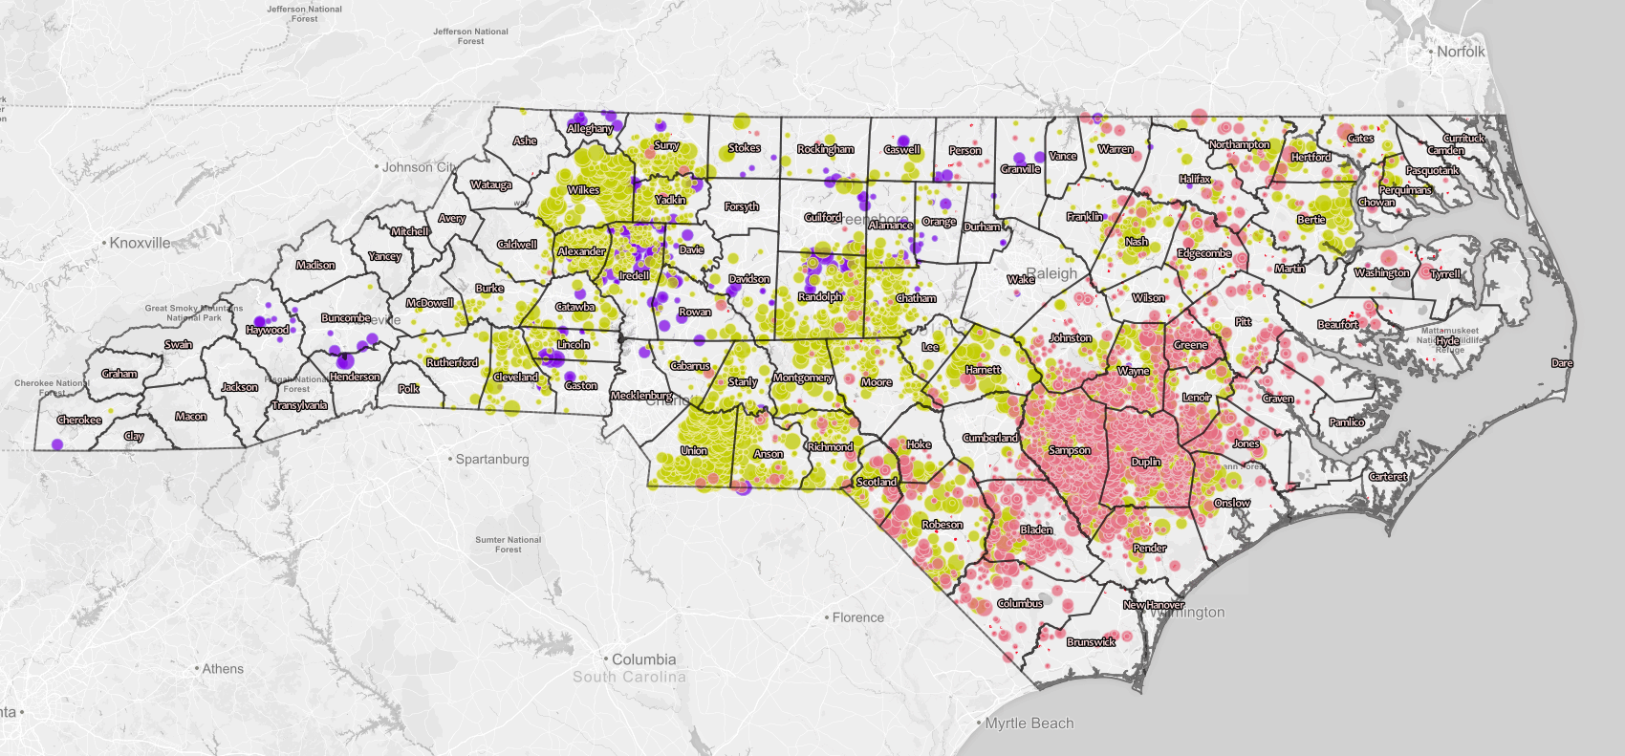
Waterkeeper Alliance and the Environmental Working Group used public data to create maps of CAFO locations in North Carolina in 2016. For more information and interactive maps, visit https://www.ewg.org/interactive-maps/2016_north_carolina_animal_feeding_operations.php#.W6KBLPZReUk.
Notes:
The reality is that in NC we have many CAFOs
Pink= hog
Purple = cattle
Yellow = poultry

Slide 11
Waterkeeper Alliance and the Environmental Working Group used public data to create maps of CAFO locations in North Carolina in 2016. For more information and interactive maps, visit https://www.ewg.org/interactive-maps/2016_north_carolina_animal_feeding_operations.php#.W6KBLPZReUk.
Notes:
The reality is that in NC we have many CAFOs
Pink= hog
Purple = cattle
Yellow = poultry

Slide 12
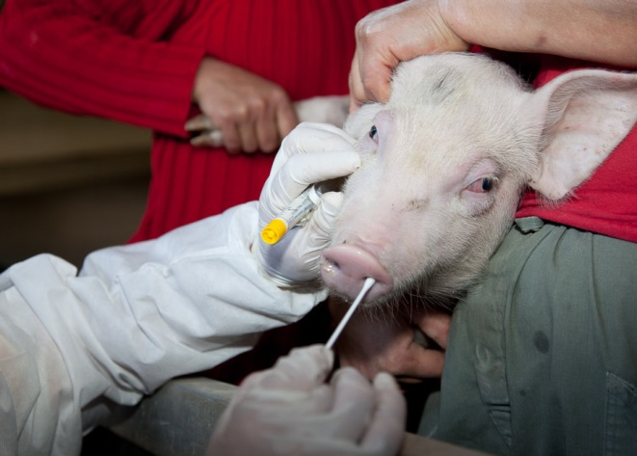
Current Surveillance
Disadvantages:
Disrupts production
Undue stress on animals
Compromises biosecurity
Fear of economic backlash
Expensive
Humans often serve as sentinels for novel diseases
Surveillance methods that are less invasive and more readily accepted by production managers are needed
Notes:
Define current surveillance – catching a pig

Slide 13
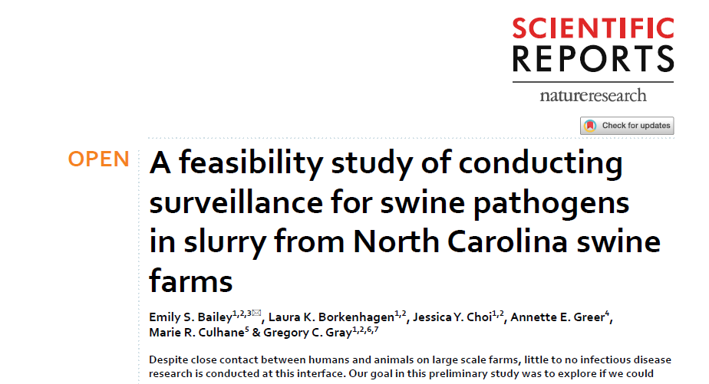

Slide 14
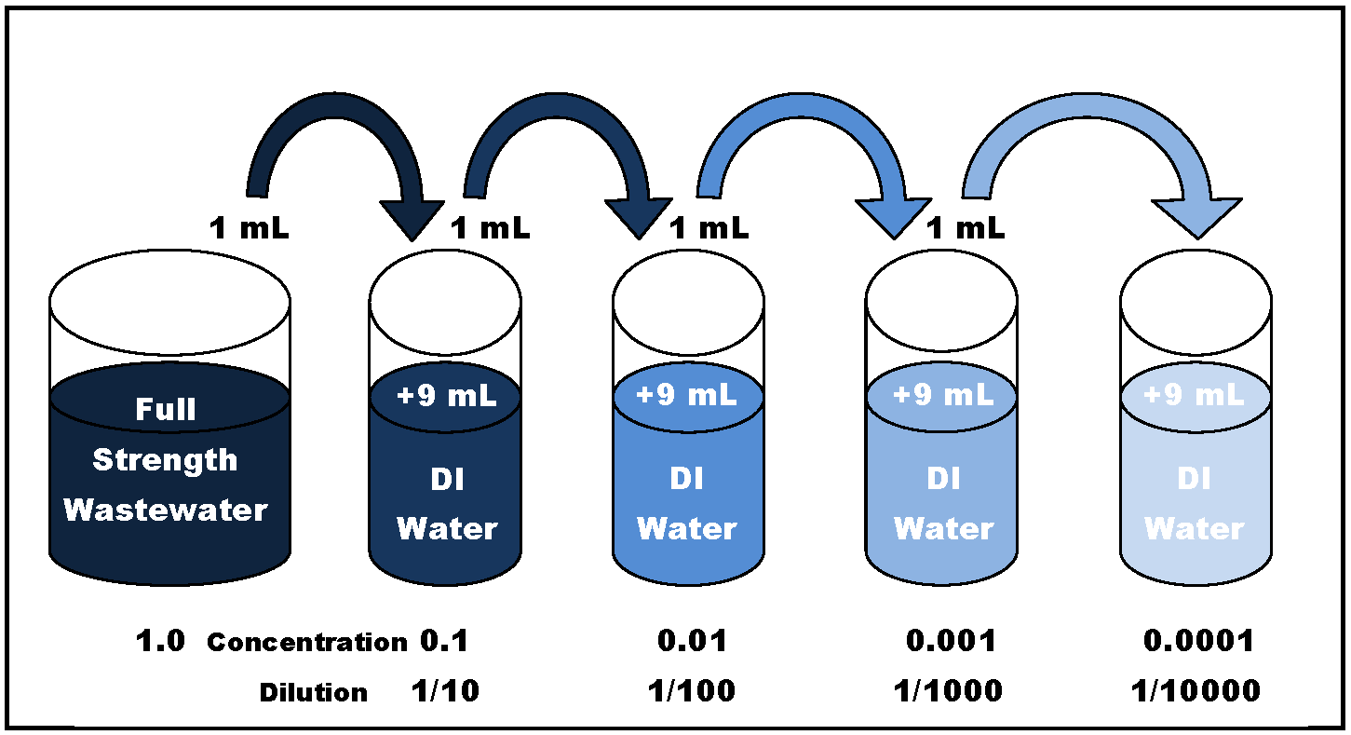
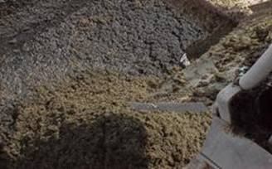
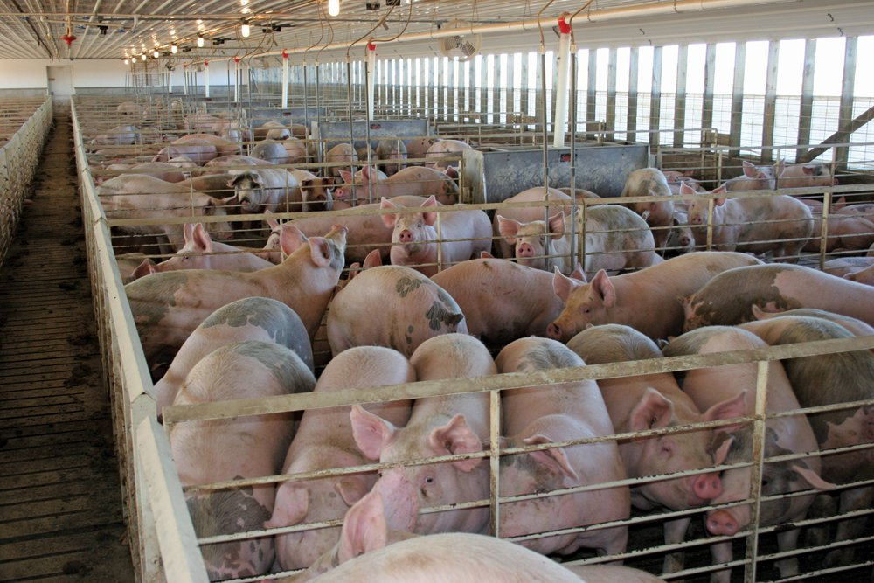
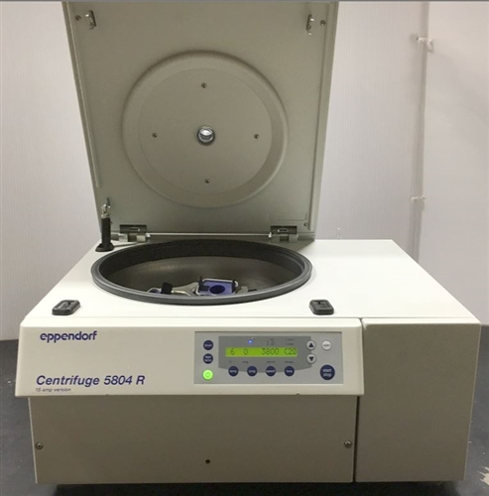
Slurry Sampling

Slide 15
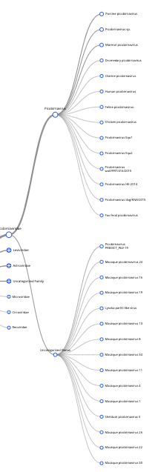
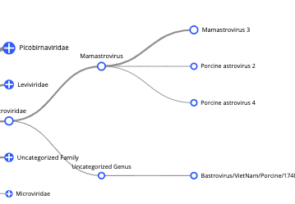
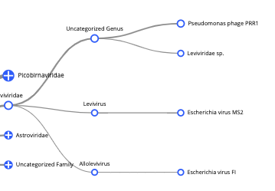
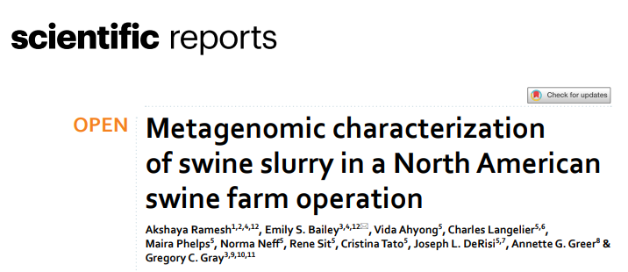
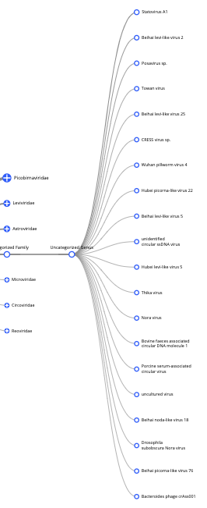
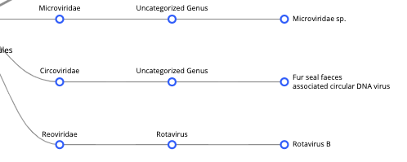
Viral breakdown
Fanning shape
hints at new viral strain

Slide 16
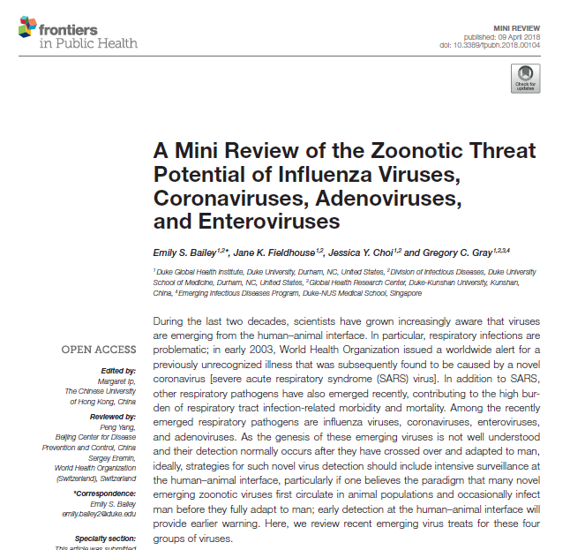
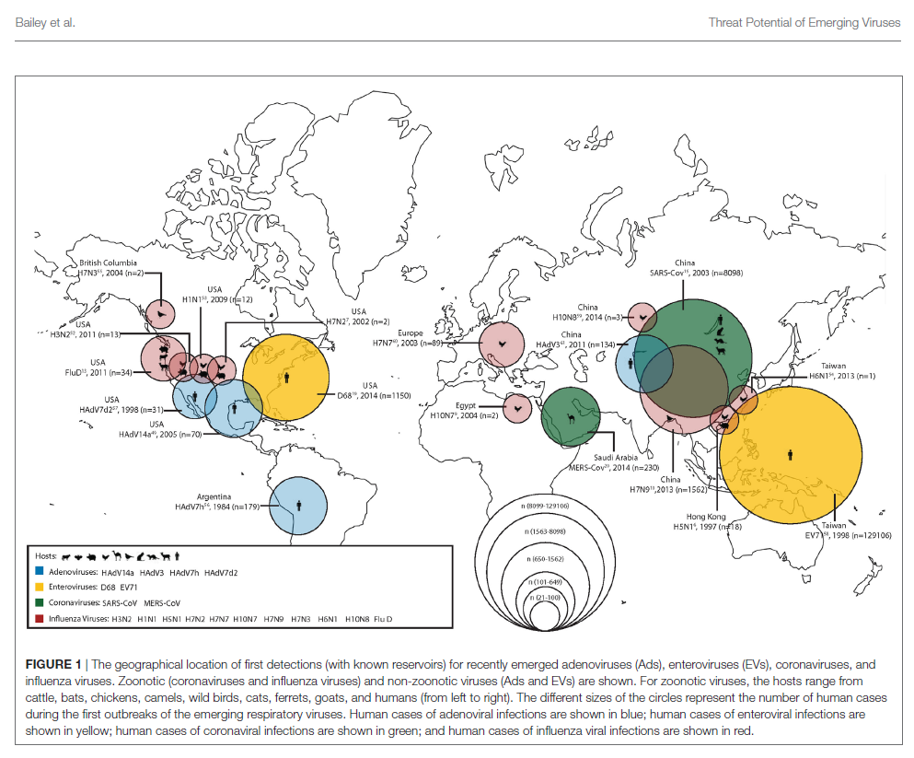

Slide 17
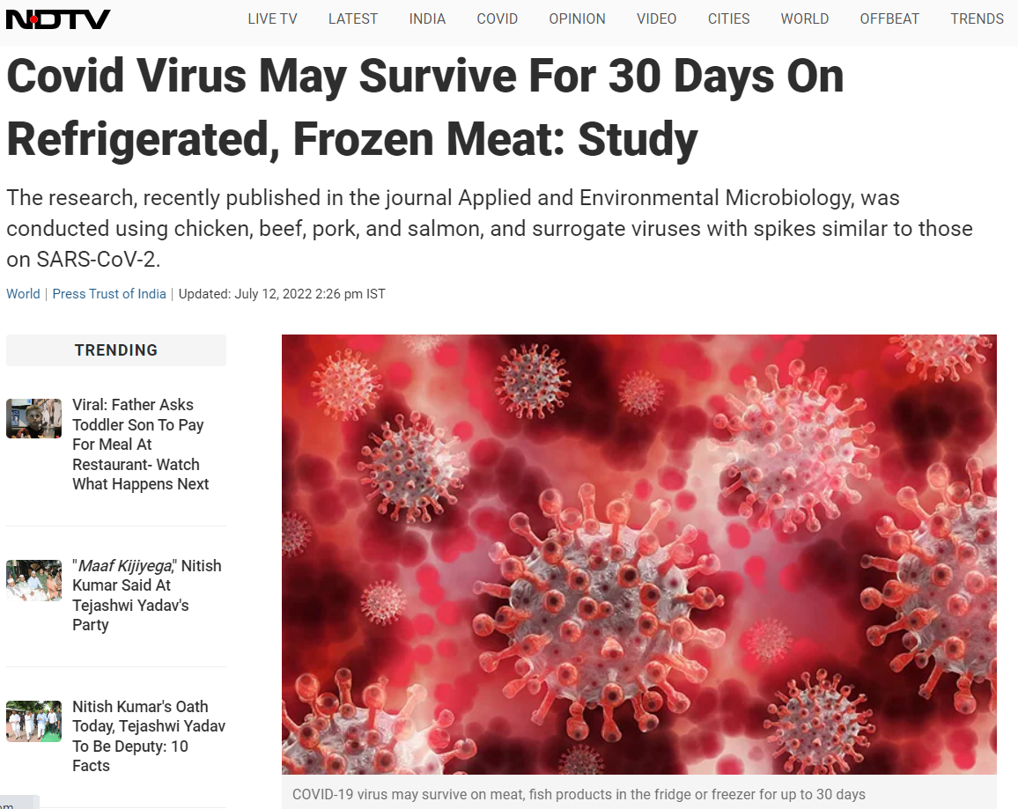
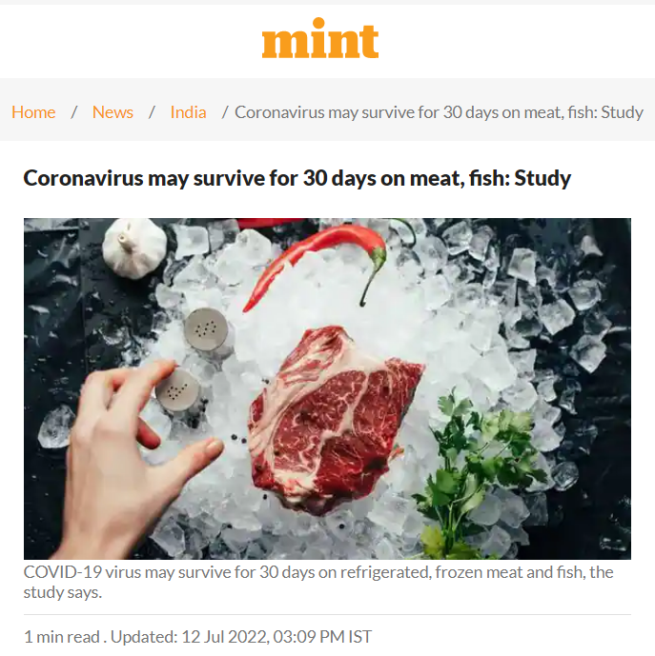
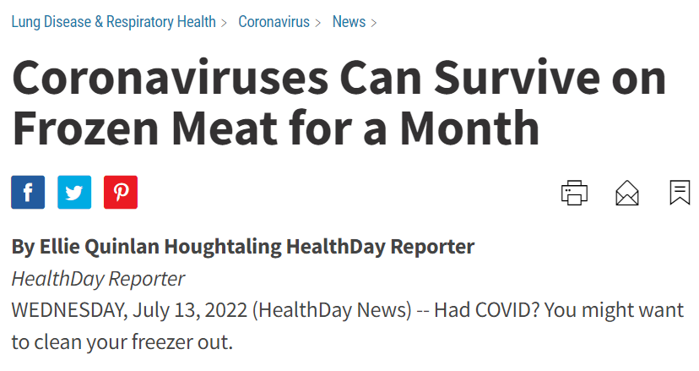

Slide 18
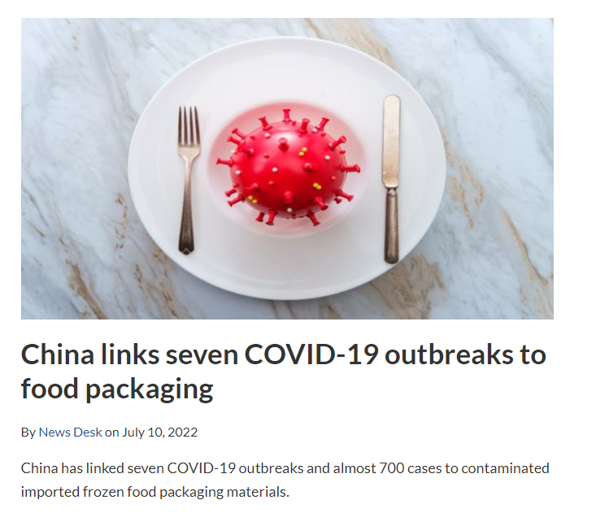
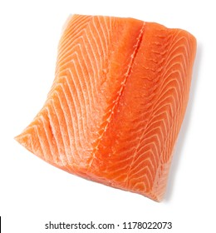
“Positive samples came from 11 European countries, six South American nations, nine Asian countries, two North American ones, and two African countries.”
Notes:
Most cases were associated with the storage and handling of fish products – cod and salmon

Slide 19
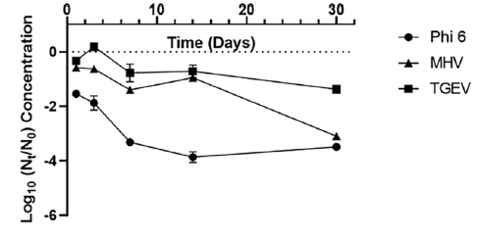
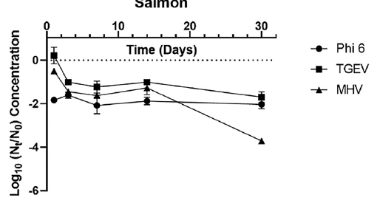
Salmon
Refrigerated (-4⁰ C)
Frozen (-20⁰ C)

Slide 20
Why does it matter?

Slide 21
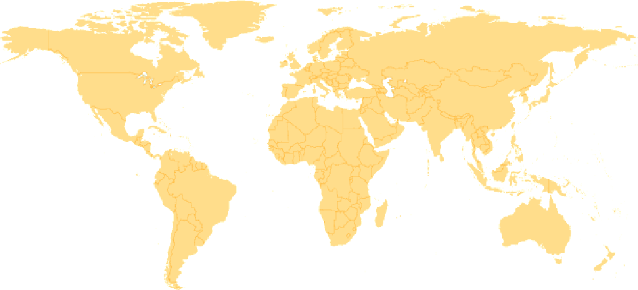
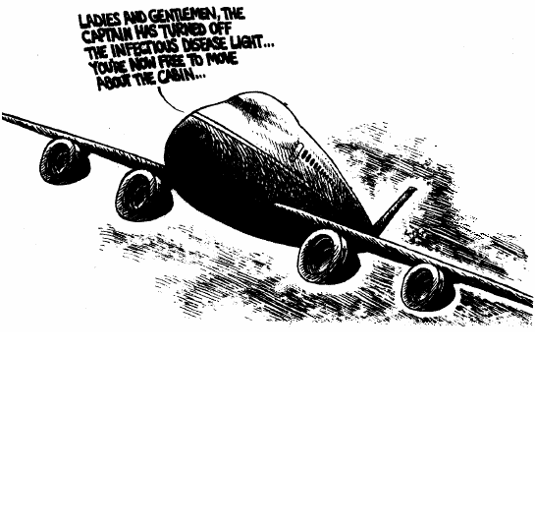
SARS OUTBREAK, 2003: Rapid spread worldwide by movement of people
“Disease is only a plane flight away”

Slide 22
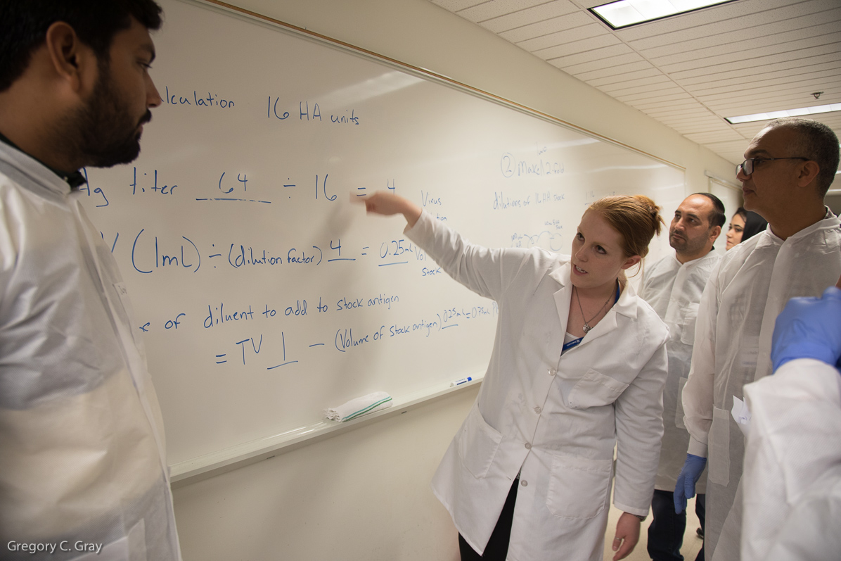
Questions?
https://sites.globalhealth.duke.edu/dukeonehealth/

